Slide 1
EECE7398 Project: A Neural Algorithm of Style Transfer
Presenter: Juncen Li

Slide 2
Idea: Patch Permutation GAN with Single Style Image
Offline learning method
Generative Adversarial Network
Only one style image is used for training

Slide 3
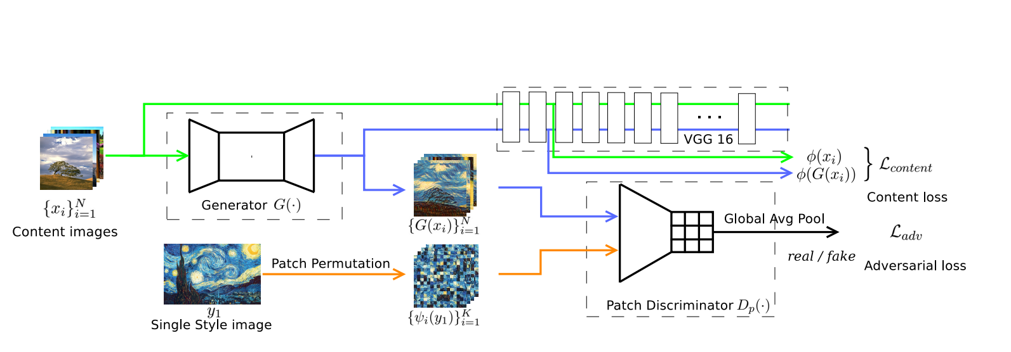
Network Overview

Slide 4
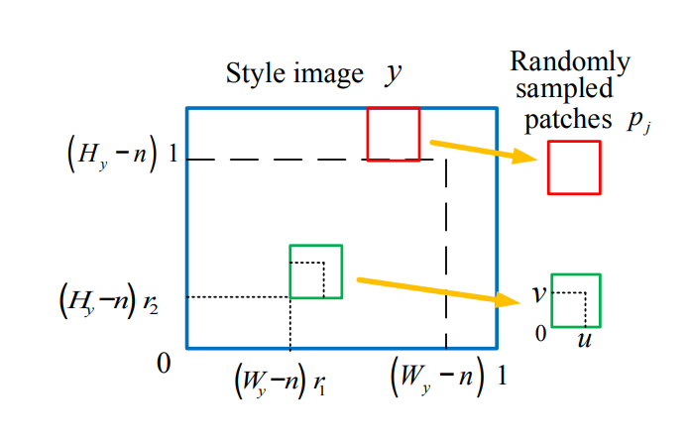
Patch Permutation
Idea: Break the style image into many patches

Slide 5
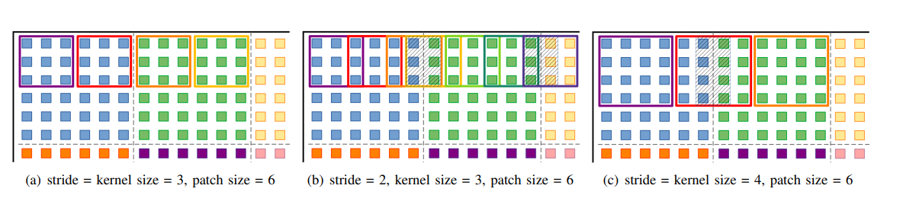
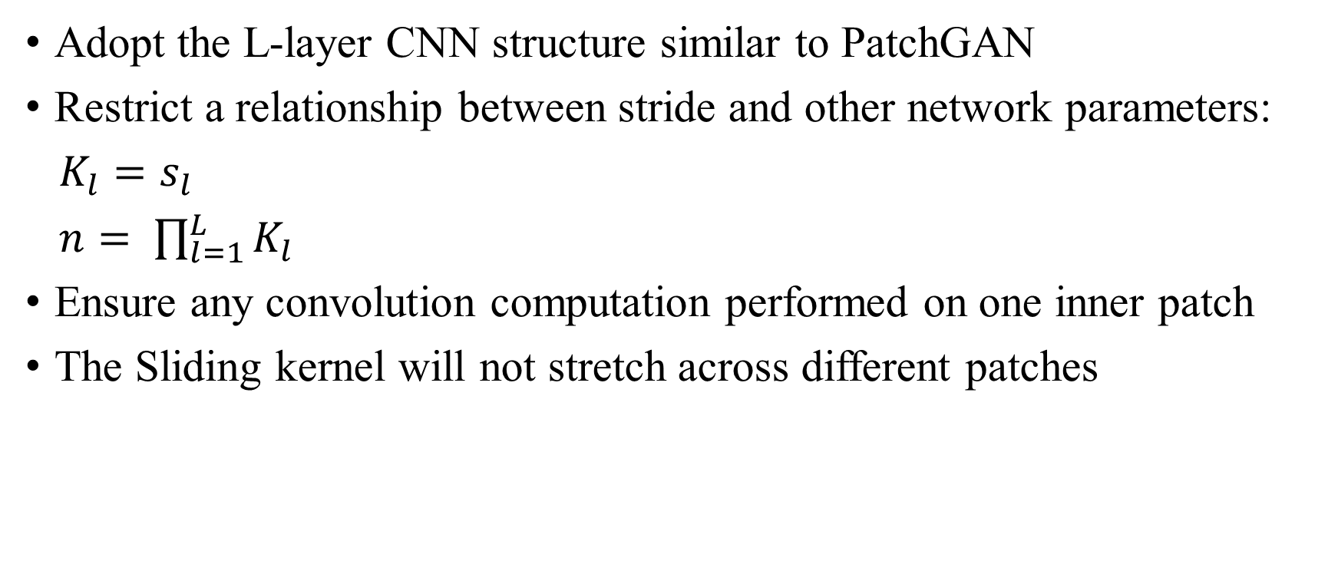
Patch Discriminator
Adopt the L-layer CNN structure similar to PatchGAN
Restrict a relationship between stride and other network parameters:
$K_{l}=s_{l}$
$n= \prod_{l=1}^{L}{K_{l}}$
Ensure any convolution computation performed on one inner patch
The Sliding kernel will not stretch across different patches

Slide 6
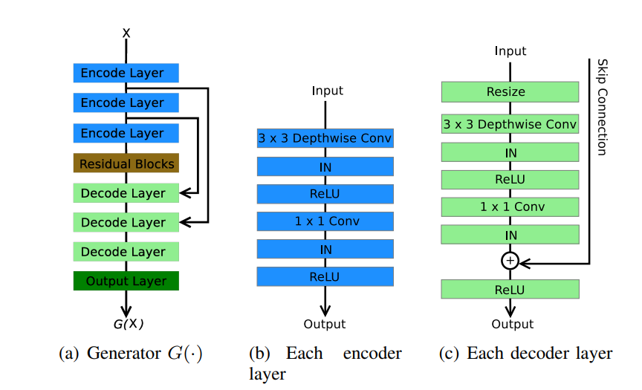
Encoder-Decoder Generator
Encoder-decoder architecture to accelerate the feed-forward computation
Account for the 8 - 9 times decrease of parameter amount
Feature maps are upsampled into two times bigger than its original size
Use Relu as activation function

Slide 7
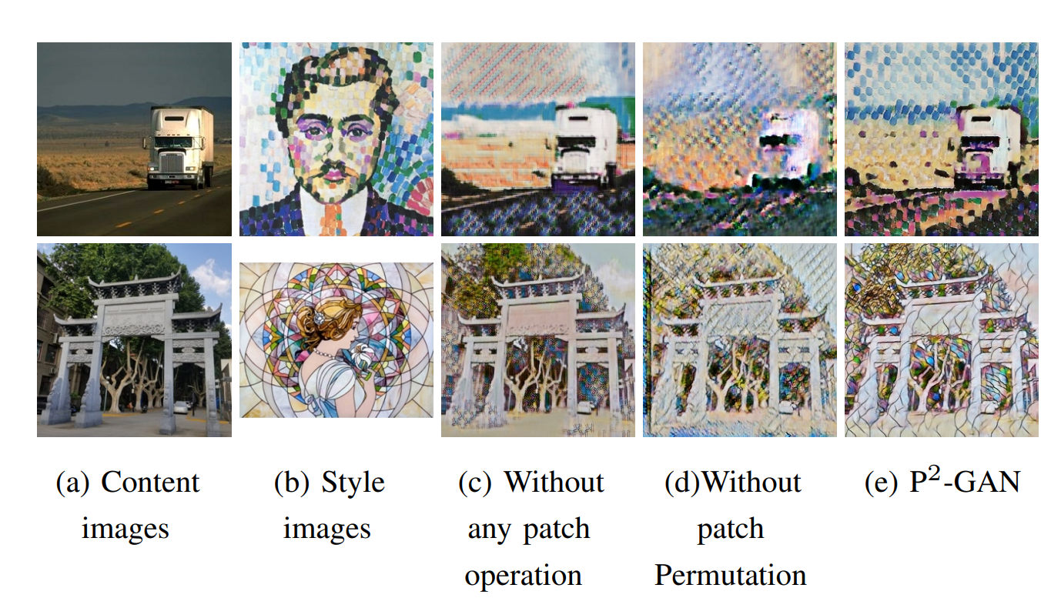
Results: Patch permutation

Slide 8
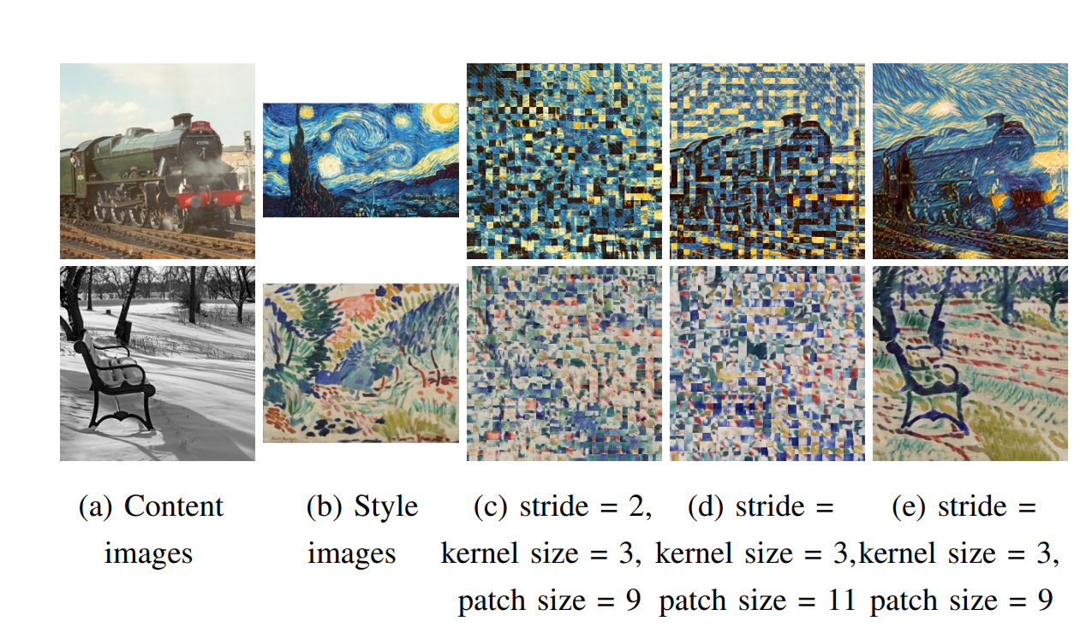
Results: Comparison with arbitrary patch discriminators

Slide 9
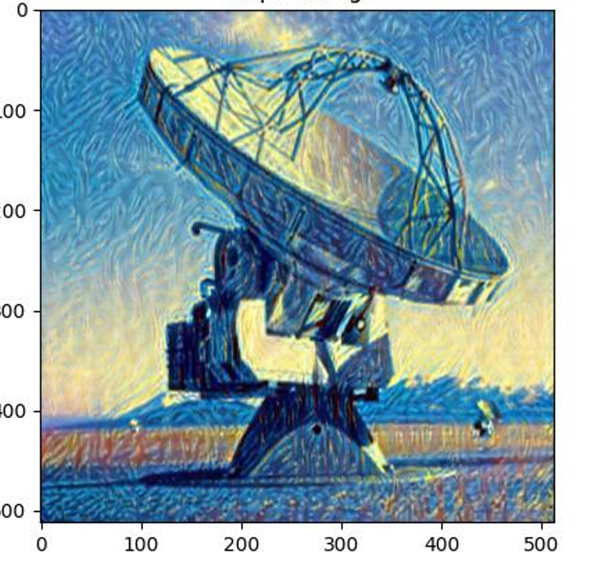
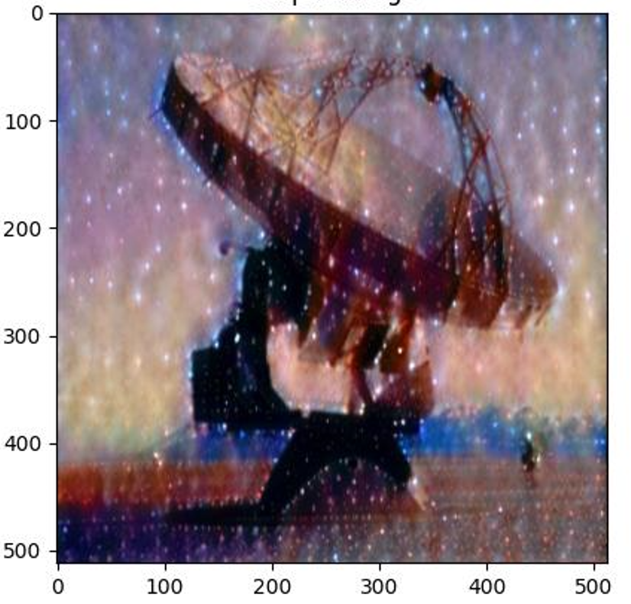
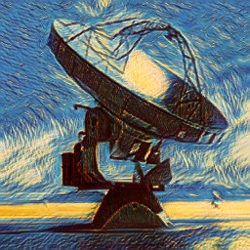
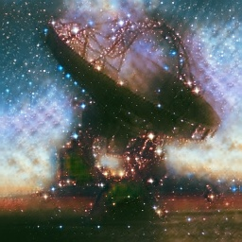
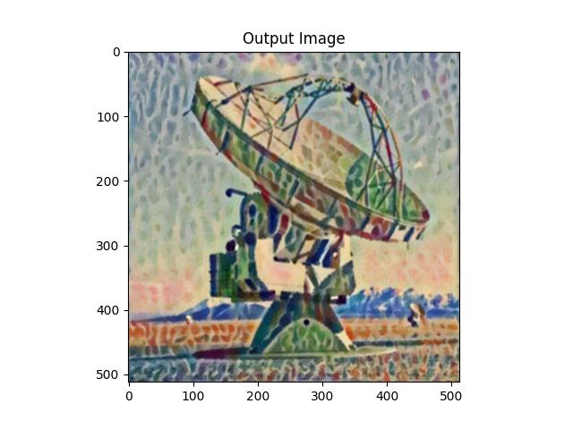
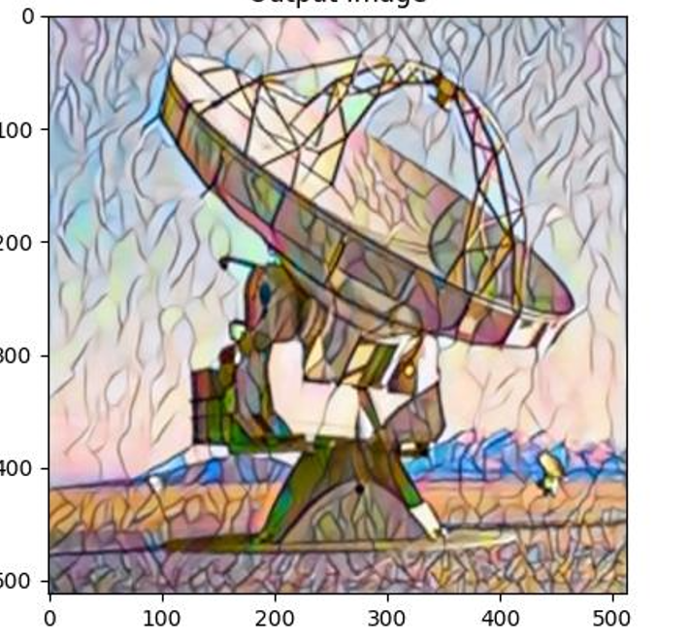
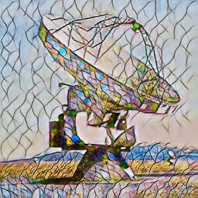
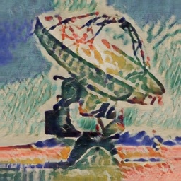
Results: Comparison with VGG
VGG: GAN:

